Slide 1
Camera Calibration with a Bar Sankar, Rajasekar
M1107-CMS05 Research Project
Oral Presentation Research Project
Chair of Machine Learning for Computer Vision
Examiner: Prof. Dr. Bjoern Andres
Supervisor: Mr. Holger Heidrich
June 5, 2023

Slide 2
Contents of the sample slide deck
Elements of TU Dresden’s Corporate Design
Logo
Font
Colors
Grid
Save template file
Accessibility
Second logos - layout options on title and content slides
Notes on working with the presentation template
Sample pages with TU Dresden content
TU Dresden
Diagrams
Infographics
DRESDEN-concept

Slide 3
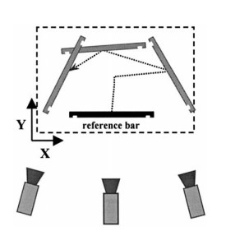
Introduction Abstract
Camera calibration – Retrieve information and process target object
Stereo calibrate – Intrinsic and extrinsic parameters
Calibration object – Reference bar of known length with marker endings
Marker identification – Color detection algorithm
Bundle adjustment, LM algorithm minimizing the least square error
Comparison study: Planar pattern, 2 different camera system

Slide 4
Introduction Overview
- Hans-Gerd Mass
Camera calibration
Process ?
Goal ?
Methodology ?
Application ?

Slide 5
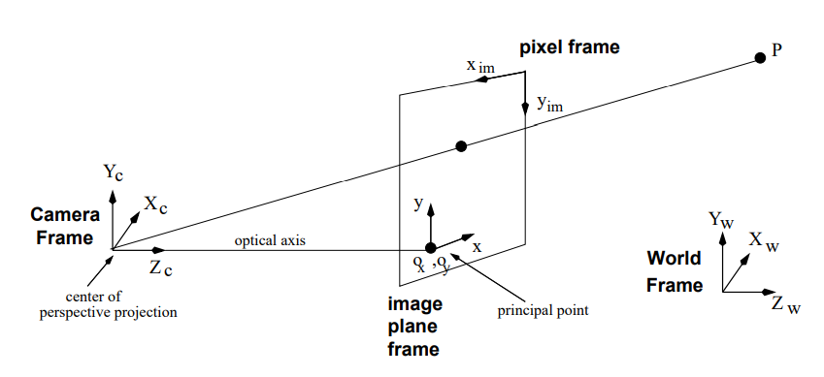
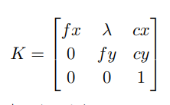
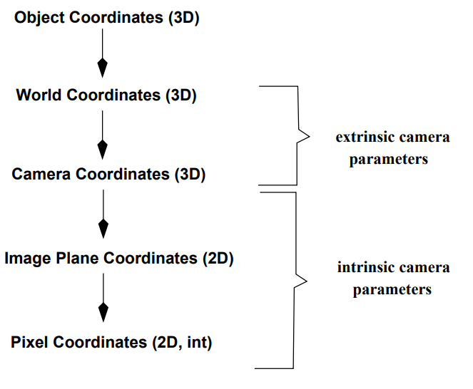
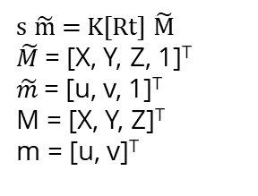
Preliminaries Notation
s $\tilde{m}$ = K[Rt] $\tilde{M}$
$\tilde{M}$= [X, Y, Z, 1]^{T}
$\tilde{m}$= [u, v, 1]^{T}
M = [X, Y, Z]^{T}
m = [u, v]^{T}
Fig Coordinate system
Fig Coordinate system

Slide 6
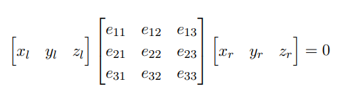
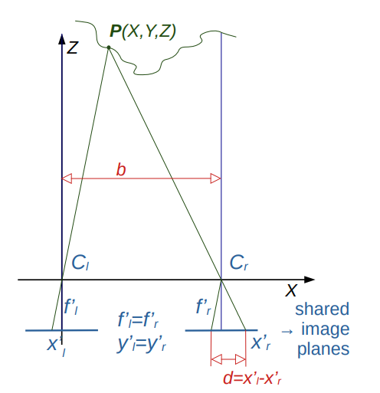
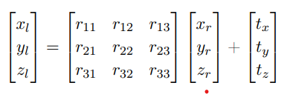
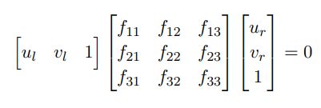
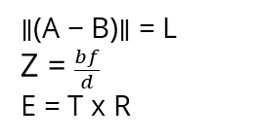
Preliminaries Stereo geometry
∥(A − B)∥ = L
Z = $\frac{bf}{d}$
E = T x R

Slide 7
Problem statement Problem definition

Slide 8
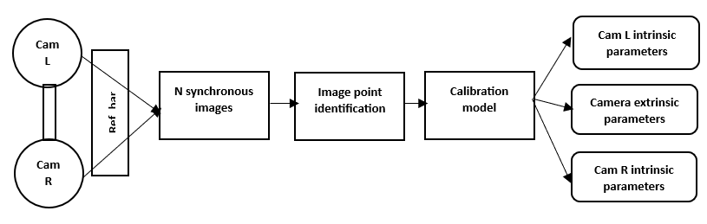
Problem statement Methodology

Slide 9
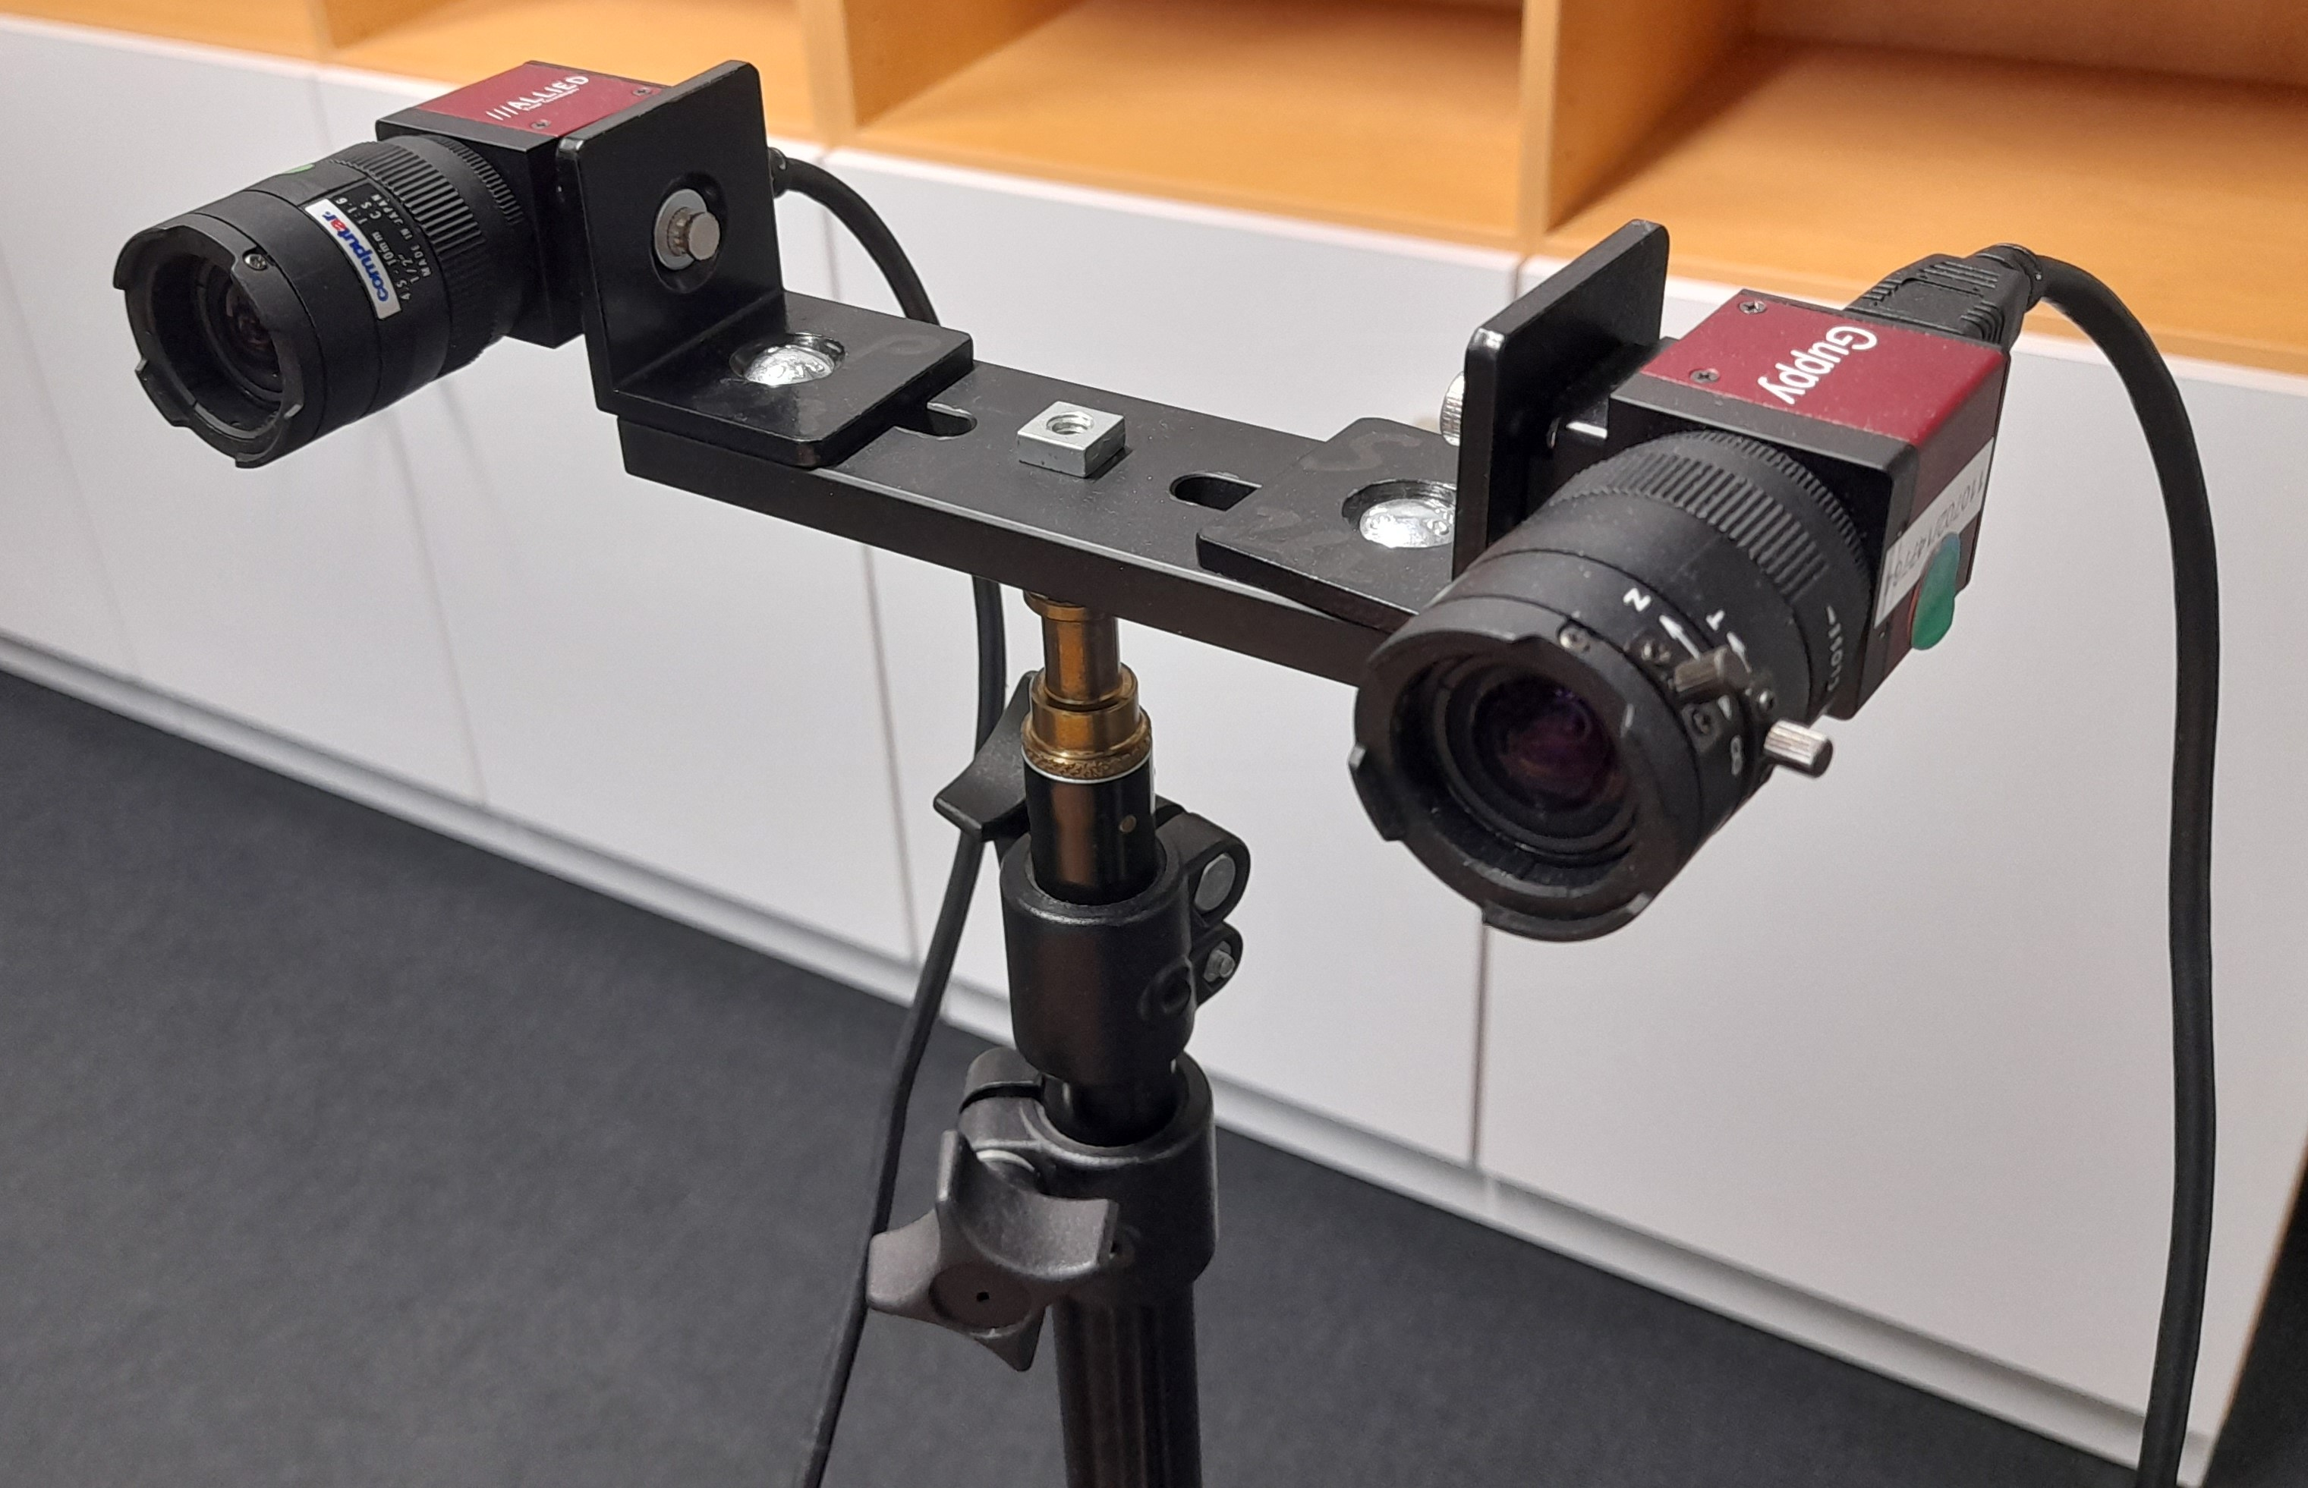
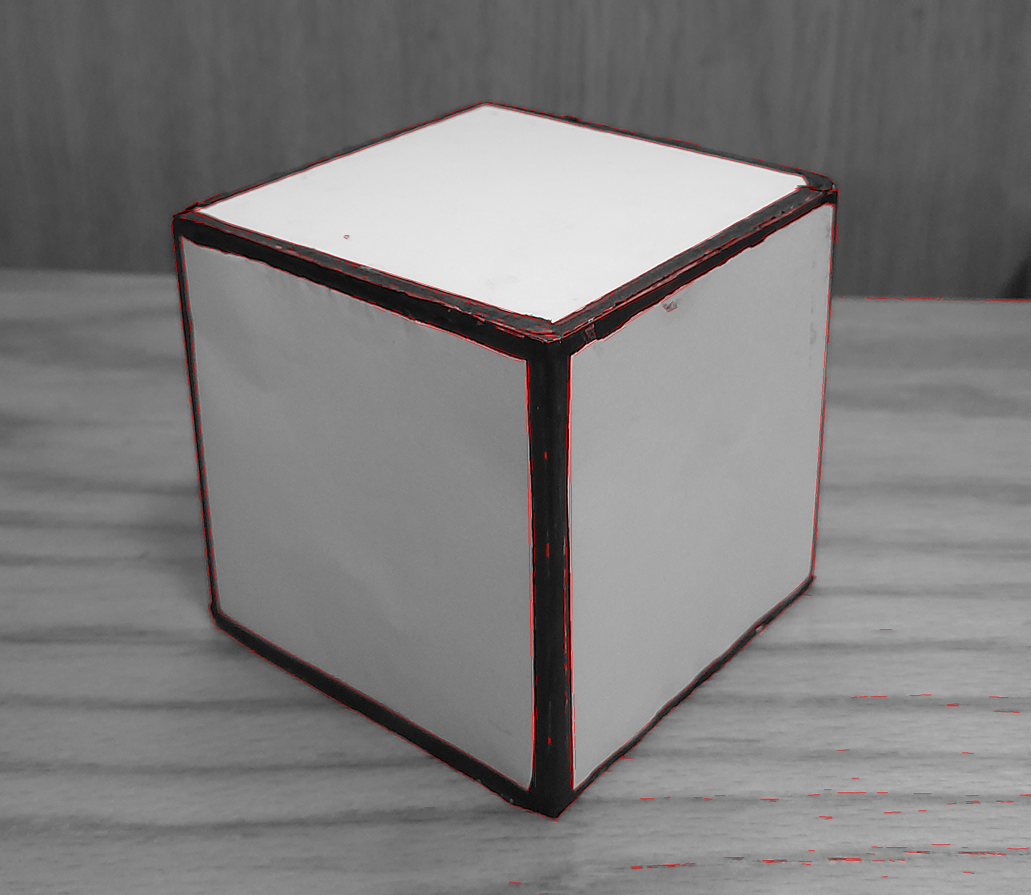
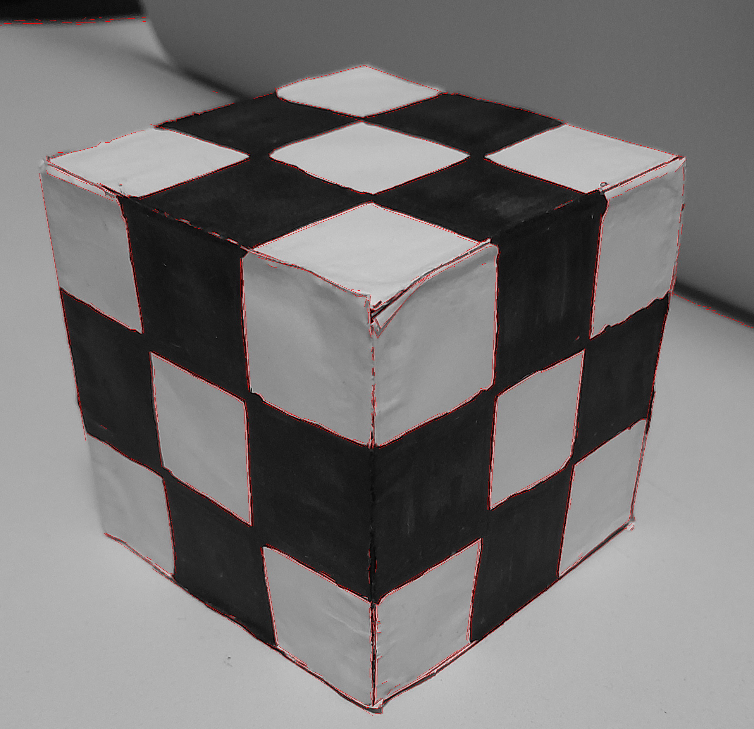
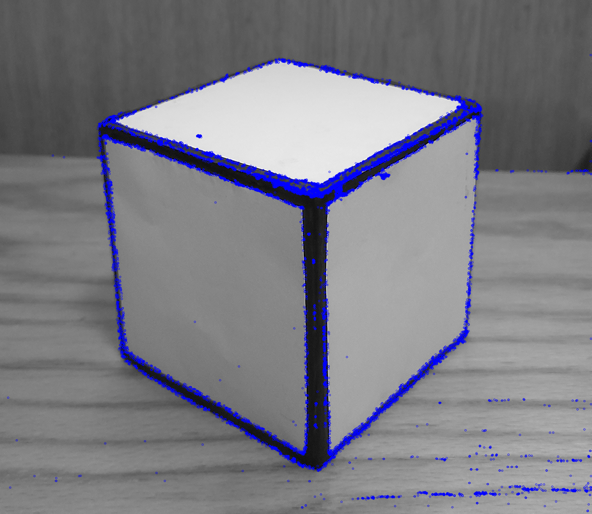
Problem statement Challenges faced

Slide 10
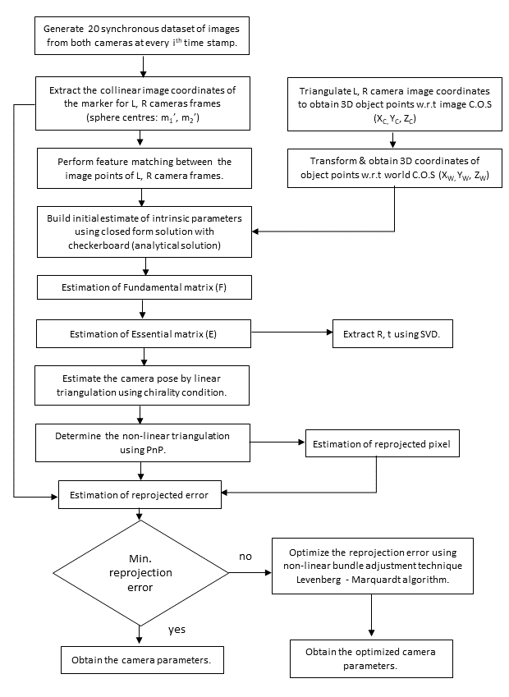
Conceptual contribution Methodology flowchart

Slide 11
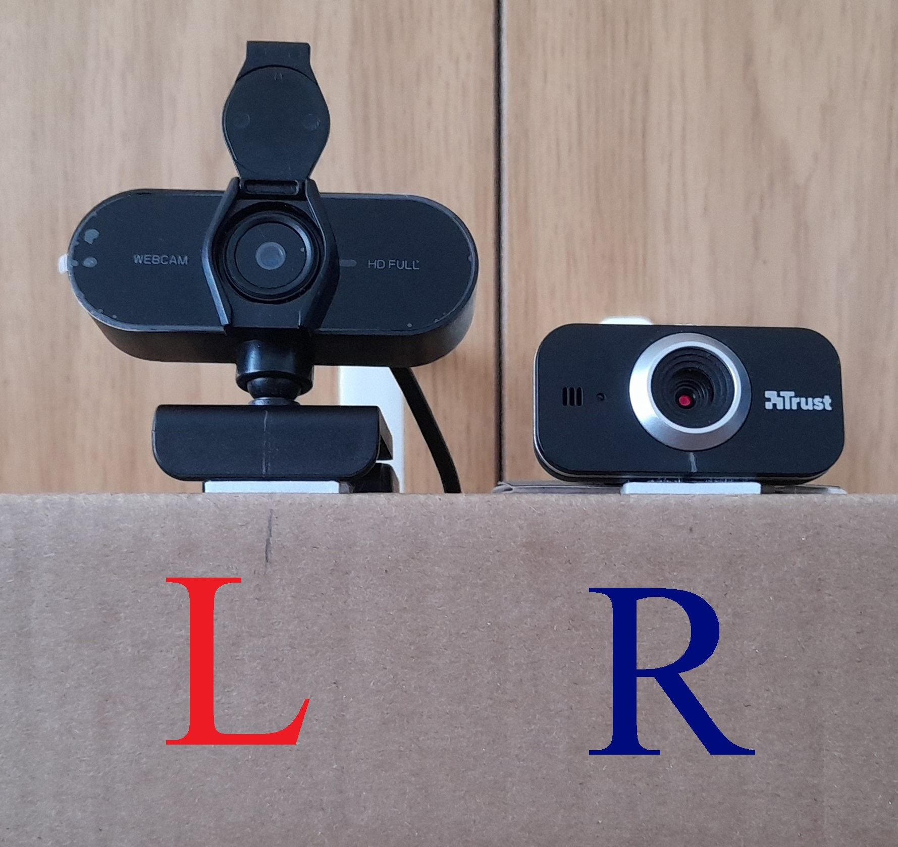
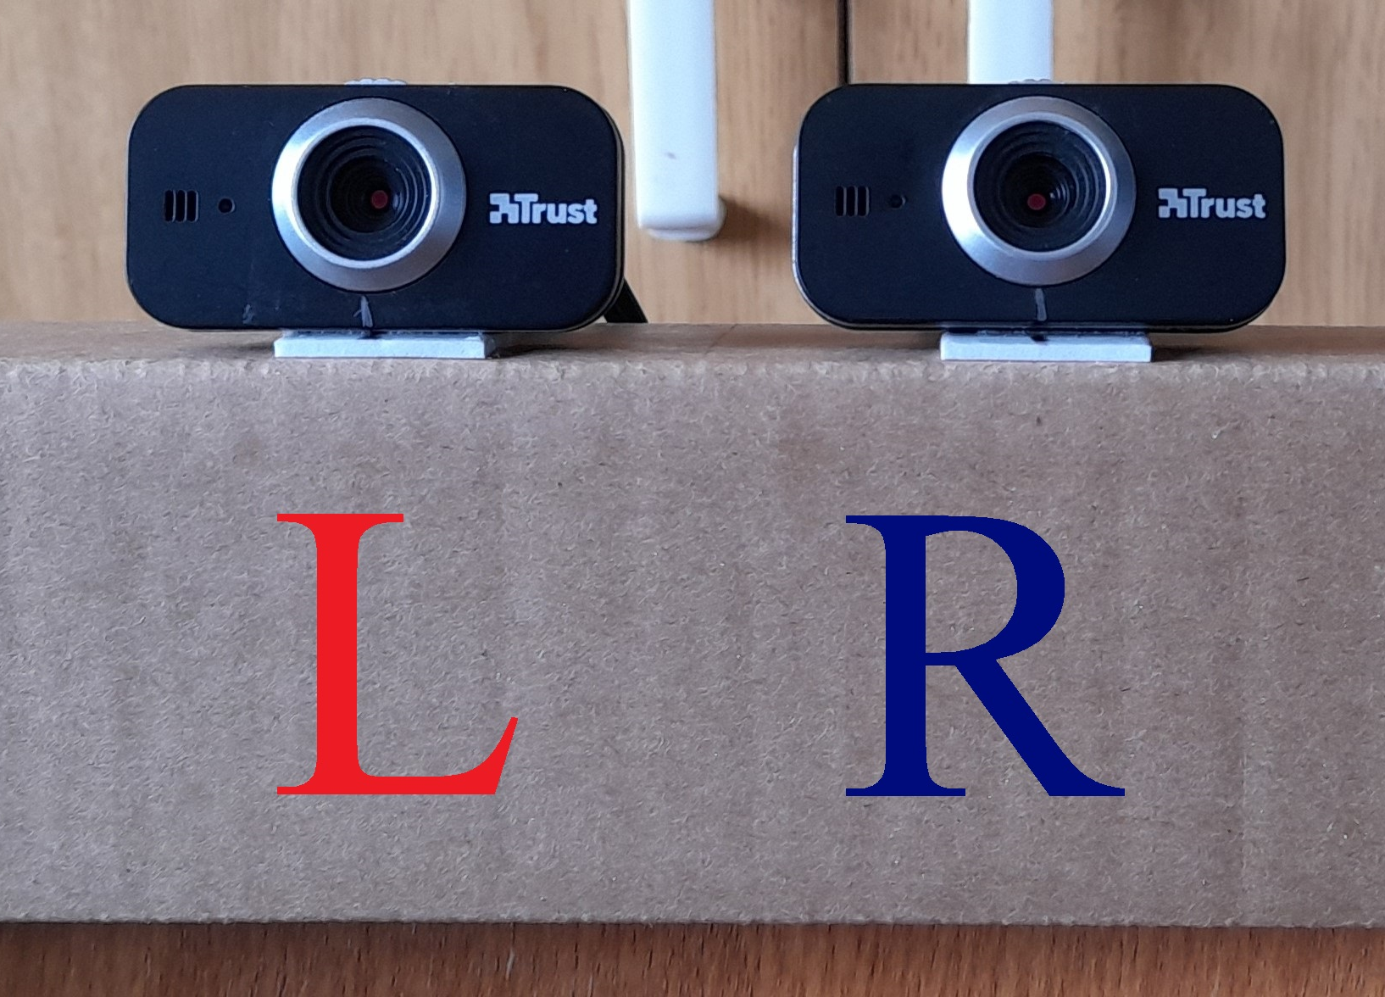
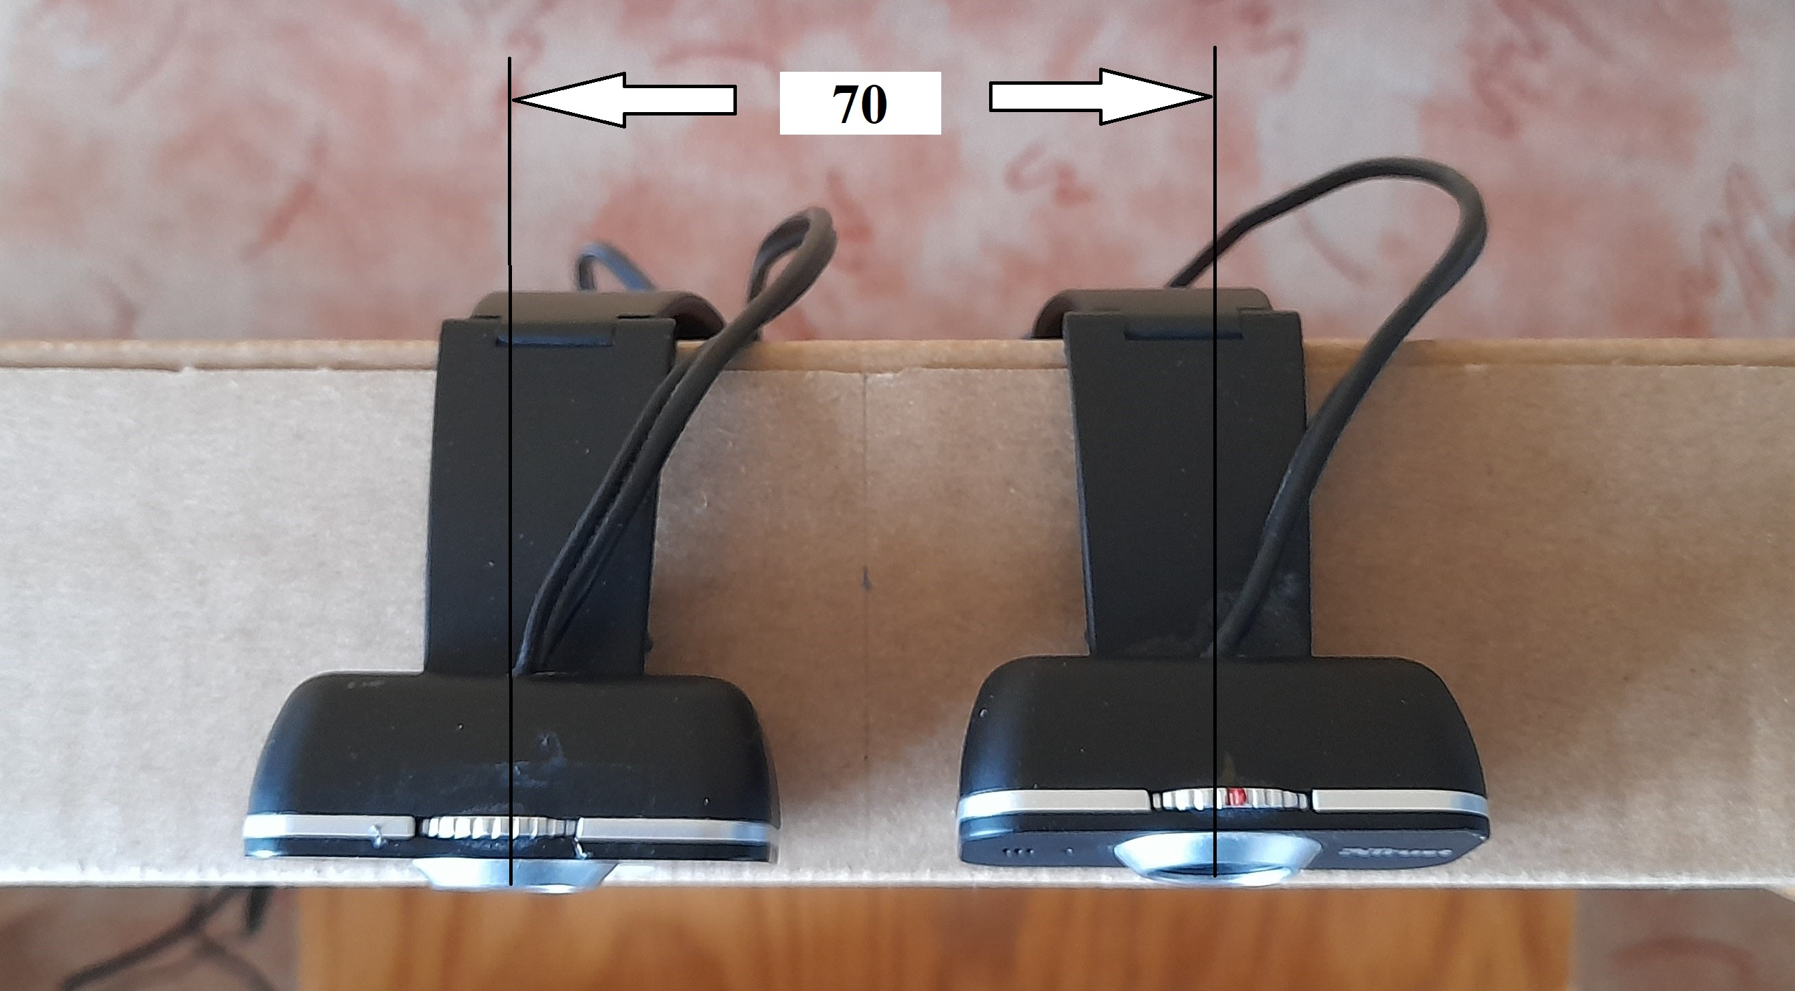
Conceptual contribution Experimental setup
Specifications | Trust 17318 Cuby webcam | Dicota Webcam PRO Plus
Resolution | HD 720p (1280x720) | Full HD 1080p (1920x1080)
Frame rate | 30 fps | 30 fps
F.O.V | 60⁰ | 60⁰
Lens | Fixed focus | Fixed focus
Sensor (WxH) | 3.0mm x 1.7mm | 3.0mm x 1.7mm

Slide 12
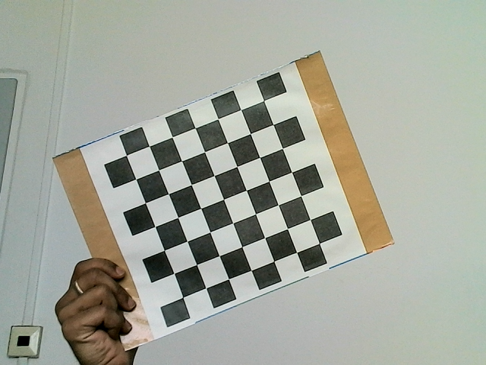
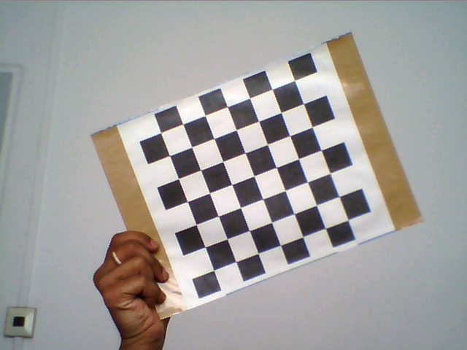
Conceptual contribution Calibration object 1 – Checker board

Slide 13
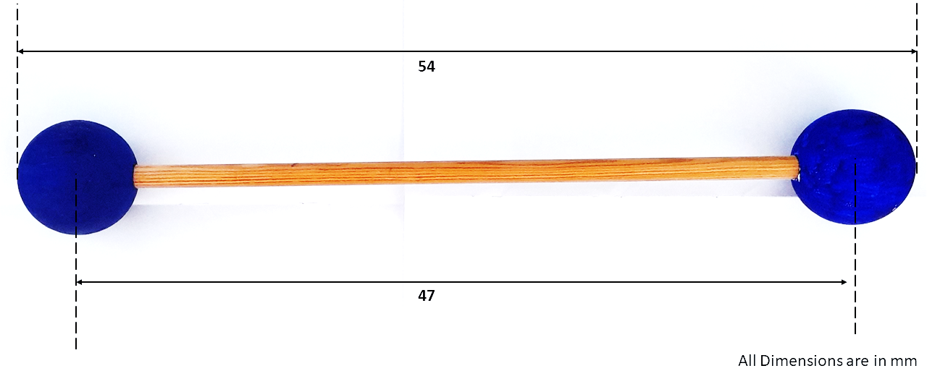
Conceptual contribution Calibration object 2 – Reference bar
The calibration procedure is as follows:[19]
1. Generate dataset of 20 synchronous images by using the Calibration object in different orientations and positions.
2. Extract the image coordinates using the Marker detection algorithm.
3. Extract the object points using the triangulation.
4. Estimate Fundamental matrix.
5. Estimate Essential matrix from fundamental matrix.
6. Estimate the camera pose.
7. Perform linear triangulation.
8. Perform nonlinear triangulation to get the 3D object points.
9. Calculate the mean error and reprojection error.
10. Apply bundle adjustment: Levenberg-Marquardt Optimization

Slide 14
Conceptual contribution Algorithm

Slide 15
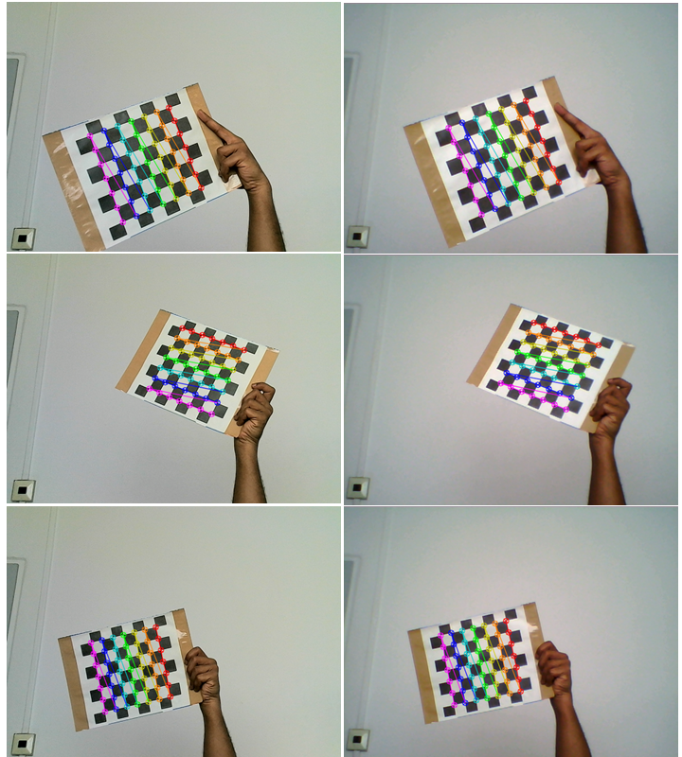
Empirical contribution Image points for checkerboard pattern

Slide 16
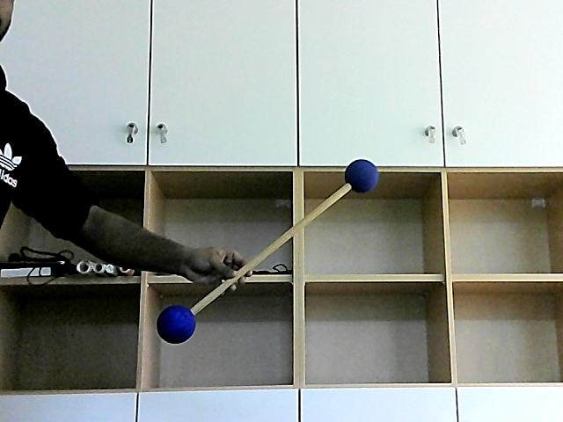
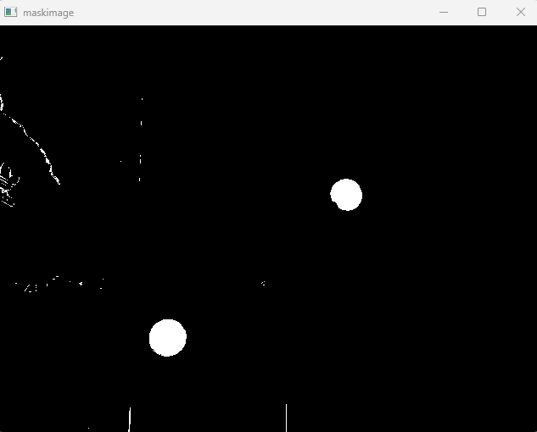
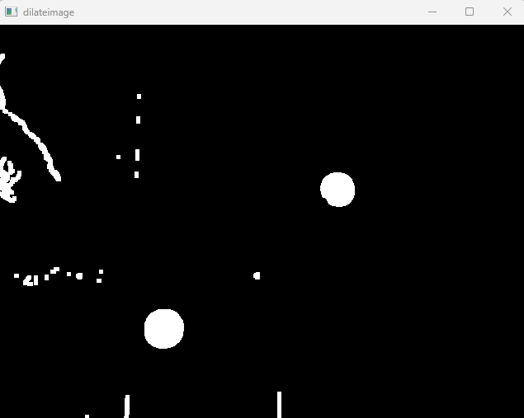
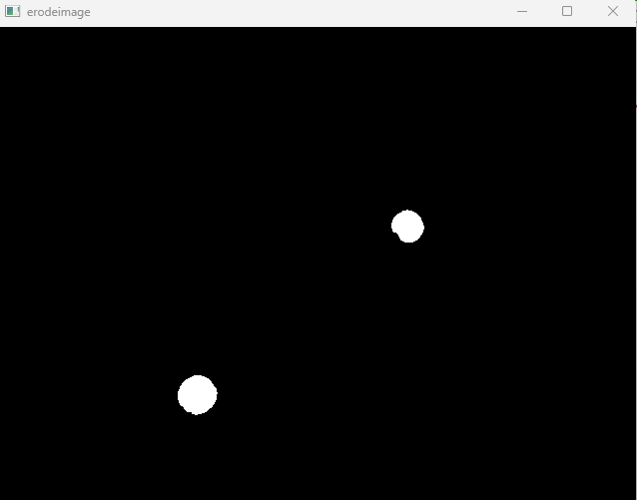
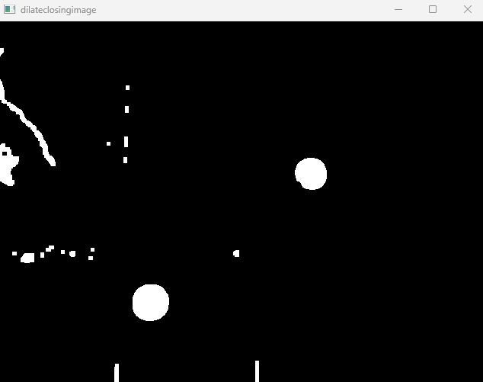
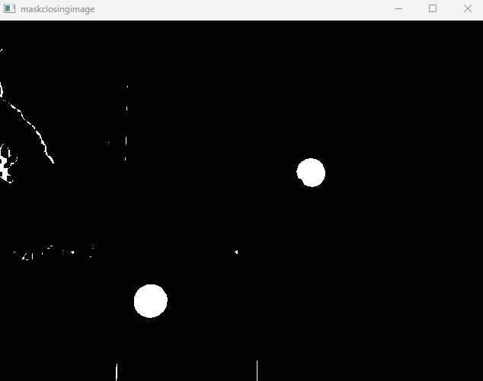
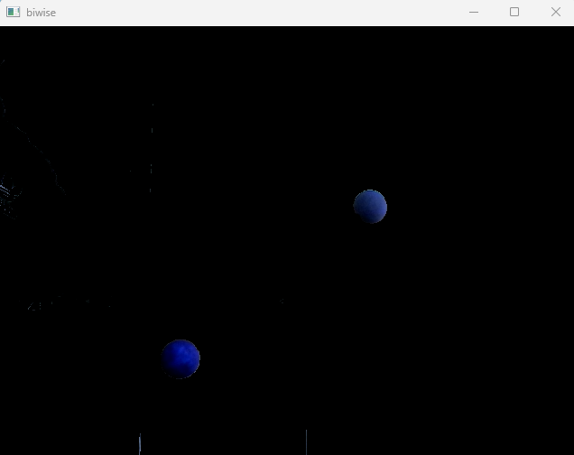
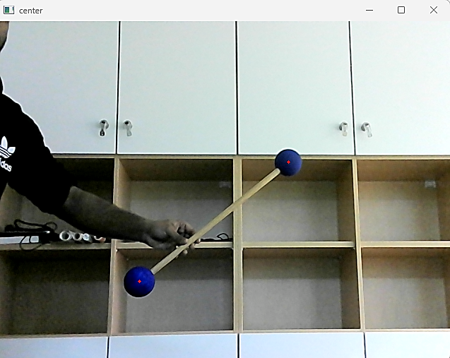
Empirical contribution Marker ending detection
Fig BGR image
Fig Mask image
Fig Dilate image
Fig Erode image
Fig Dilate closing image
Fig Mask closing image
Fig Bitwise image
Fig Sphere centre

Slide 17
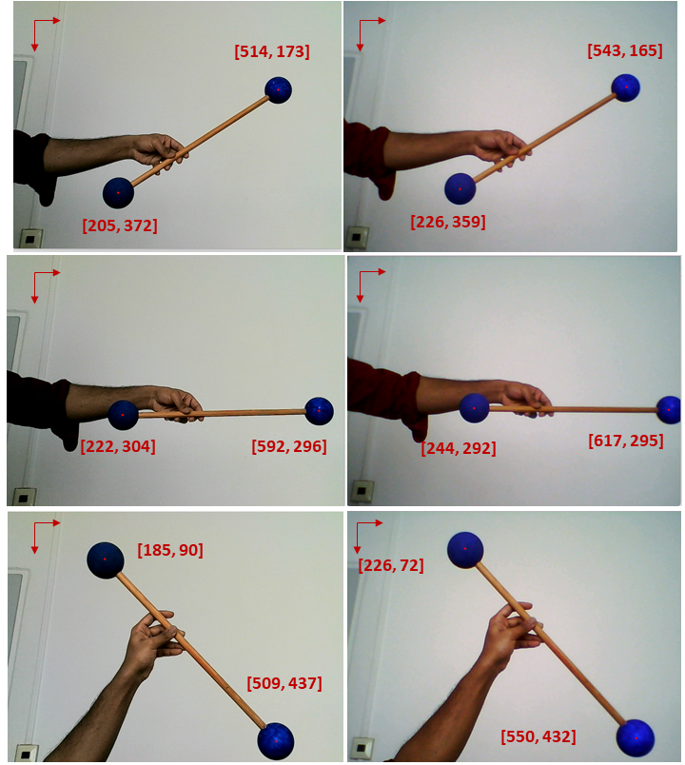
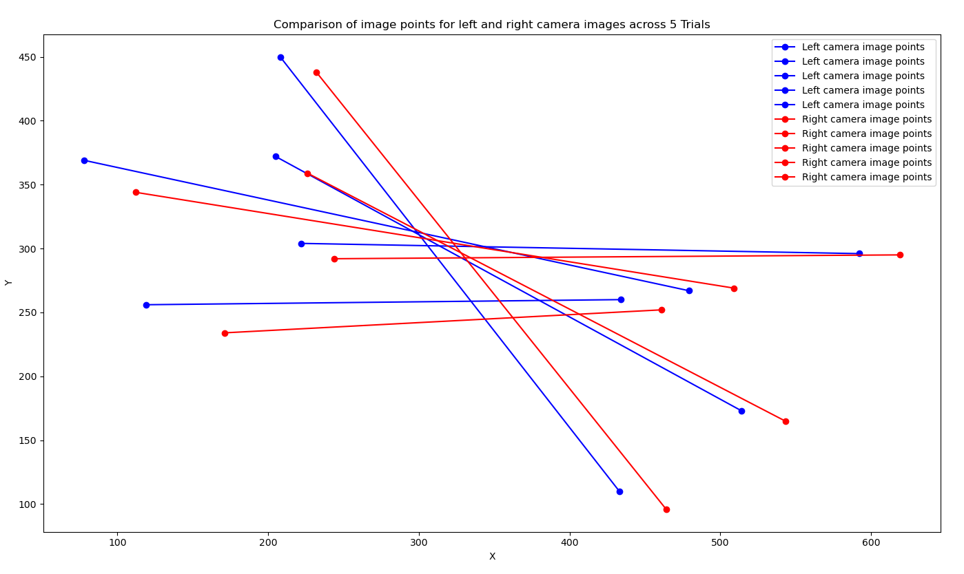
Empirical contribution Comparison of marker coordinates

Slide 18
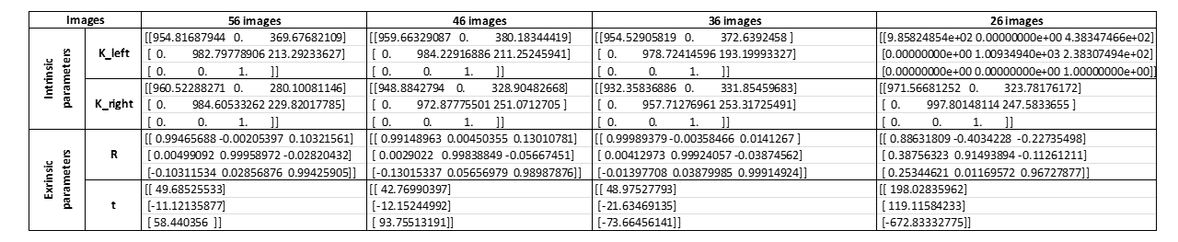
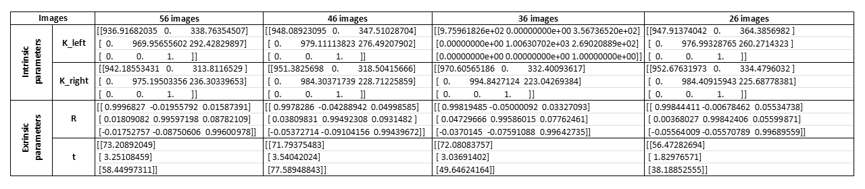
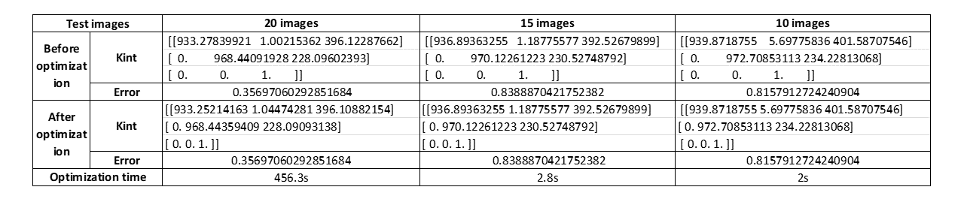
Empirical contribution Comparison of camera parameters
Table Comparison of camera parameters for different camera system for no of images
Table Comparison of camera parameters for same camera system for no of images
Table Comparison of camera parameters for optimization for no of images

Slide 19
Contents of the sample slide deck

